Slide 1
Introduction to JavaScript
Mr Mack 2022

Slide 2
Organizing your JavaScript code
One of the most daunting parts of JavaScript is learning how to organize your code. The reason this subject can be so overwhelming is not because JavaScript is so much more complex than other languages, but because it is incredibly forgiving! Many languages force you into using specific patterns and data structures in your code, but that is not true in JavaScript.
In the beginning, this is a great thing! For example, if you just want to make a simple button on your webpage do something, you can set that up in a couple lines of code. However, as your program becomes more complex, it can become hard to maintain unless you take care to organize your code, and because JavaScript is such a flexible language, how you do that is entirely up to you. For many coders, making decisions about design patterns is crippling, so we’re here to help.

Slide 3
Organizing your JavaScript code
This lesson series is going to cover a few of the most common design patterns that occur in modern JavaScript code. We will discuss some pros and cons of each pattern and will give you a chance to practice using each pattern in a project.
The patterns we’ll be covering in this series are:
Plain Old JavaScript Objects and Object Constructors
Factory Functions and the Module Pattern
Classes
ES6 Modules
Notes:
Going through these will give us a chance to learn about a few other important concepts in JavaScript such as “closure”, “prototypes”, “IIFEs” and more! This series covers the most important parts of JavaScript after simply learning the basics of the language… are you ready?

Slide 4
Resources
The book You Don’t Know JS (YDKJS) is free on GitHub, and explains how Javascript works “under the hood”. If you ever wondered why JavaScript works the way it does, this book is for you!

Slide 5
OBJECTS AND OBJECT CONSTRUCTORS

Slide 6
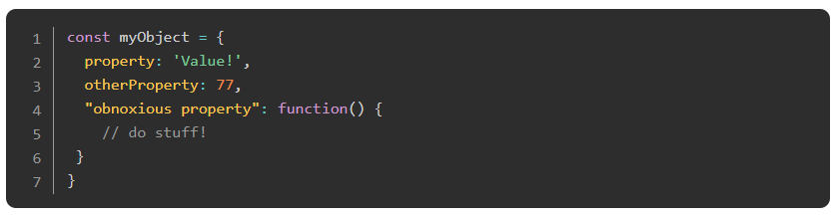
Introduction
In our JavaScript fundamentals course, you should have learned the basics of using objects to store and retrieve data. Let’s start with a little refresher.
There are multiple ways to define objects but in most cases, it is best to use the object literal syntax as follows:

Slide 7
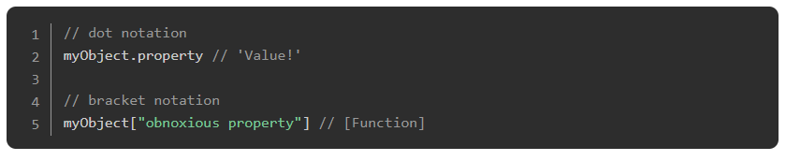
Introduction
There are also 2 ways to get information out of an object: dot notation and bracket notation.

Slide 8
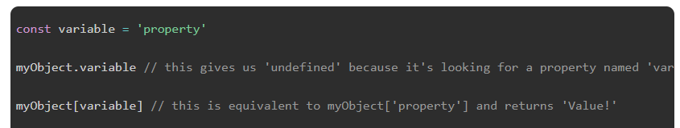
Introduction
Which method you use will depend on context. Dot notation is cleaner and is usually preferred, but there are plenty of circumstances when it is not possible to use it. For example, myObject."obnoxious property" won’t work because that property is a string with a space in it. Likewise, you cannot use variables in dot notation:

Slide 9
Learning Outcomes
Write an object constructor and instantiate the object.
Describe what a prototype is and how it can be used.
Explain prototypal inheritance.
Understand the basic do’s and don’t’s of prototypical inheritance.
Explain what Object.create does.

Slide 10
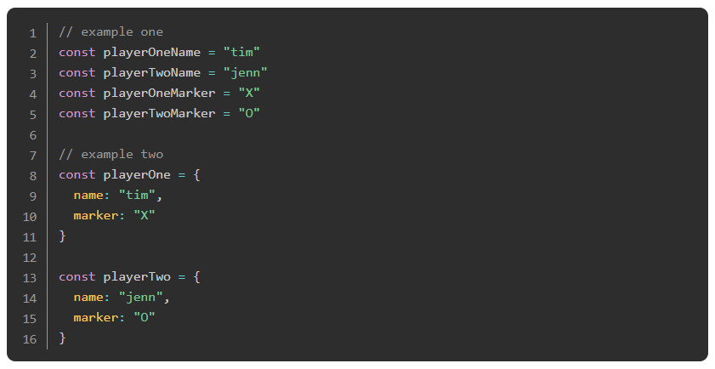
Objects as a Design Pattern
One of the simplest ways you can begin to organize your code is by simply grouping things into objects. Take these examples from a ‘tic tac toe’ game:

Slide 11
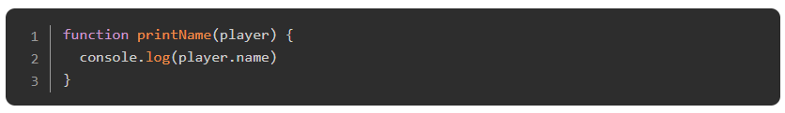
Objects as a Design Pattern
At first glance, the first doesn’t seem so bad.. and it actually takes fewer lines to write than the example using objects, but the benefits of the second approach are huge! Let me demonstrate:

Slide 12

Objects as a Design Pattern
This is something that you just could NOT do with the example one setup. Instead, every time you wanted to print a specific player’s name, you would have to remember the correct variable name and then manually console.log it:

Slide 13
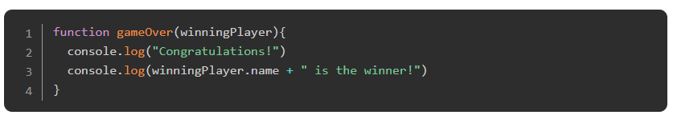
Objects as a Design Pattern
Again, this isn’t that bad… but what if you don’t know which player’s name you want to print?
Notes:
Or, what if we aren’t making a 2 player game, but something more complicated such as an online shopping site with a large inventory? In that case, using objects to keep track of an item’s name, price, description and other things is the only way to go. Unfortunately, in that type of situation, manually typing out the contents of our objects is not feasible either. We need a cleaner way to create our objects, which brings us to…

Slide 14
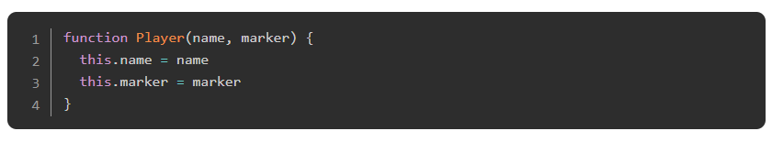
Object Constructors
When you have a specific type of object that you need to duplicate like our player or inventory items, a better way to create them is using an object constructor, which is a function that looks like this:

Slide 15
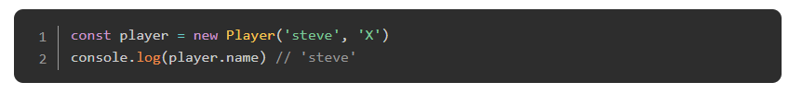
Object Constructors
and which you use by calling the function with the keyword new.

Slide 16
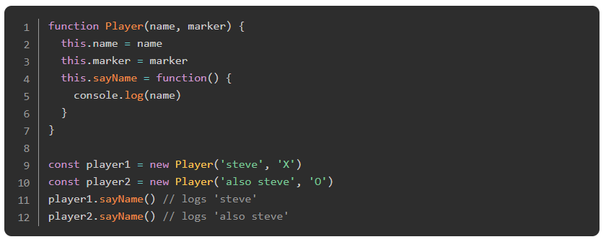
Object Constructors
Just like with objects created using the Object Literal method, you can add functions to the object:

Slide 17
Exercise
Write a constructor for making “Book” objects. We will revisit this in the project at the end of this lesson. Your book objects should have the book’s title, author, the number of pages, and whether or not you have read the book.
Put a function into the constructor that can report the book info like so:
Note: It is almost always best to return things rather than putting console.log() directly into the function. In this case, return the info string and log it after the function has been called:
Try this!

Slide 18
The Prototype
Before we go much further, there’s something important you need to understand about JavaScript objects. All objects in JavaScript have a prototype. Stated simply, the prototype is another object that the original object inherits from, which is to say, the original object has access to all of its prototype’s methods and properties.
This concept is an important one, so you’ve got some reading to do. Make sure you really get this before moving on!

Slide 19
Read
This article is a straightforward introduction and demonstration of the concept. It also covers constructors again.. good time for a review! The important bits here, once you’ve covered the basics, are ‘Prototype-based inheritance’ and the ‘Prototype chain’.
Notes:
🍐 This is a Pear Deck Web Slide.
🍐 To edit the type of question, go back to the "Ask Students a Question" in the Pear Deck sidebar.

Slide 20
Going Deeper
To go a bit deeper into both the chain and inheritance, spend some time with this great article. As usual, doing the exercises at the end will help cement this knowledge in your mind. Don’t skip them! Important note: This article makes heavy use of __proto__ which is not generally recommended. The concepts here are what we’re looking for at the moment. We will soon learn another method or two for setting the prototype.
Notes:
🍐 This is a Pear Deck Web Slide.
🍐 To edit the type of question, go back to the "Ask Students a Question" in the Pear Deck sidebar.

Slide 21
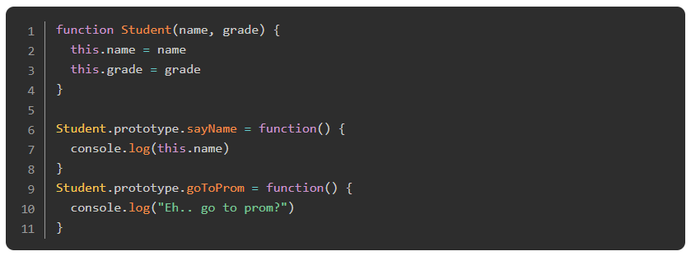
The Prototype
If you’ve understood the concept of the prototype, this next bit about constructors will not be confusing at all!
Notes:
If you’re using constructors to make your objects it is best to define functions on the prototype of that object. Doing so means that a single instance of each function will be shared between all of the Student objects. If we declare the function directly in the constructor, like we did when they were first introduced, that function would be duplicated every time a new Student is created. In this example, that wouldn’t really matter much, but in a project that is creating thousands of objects, it really can make a difference.

Slide 22
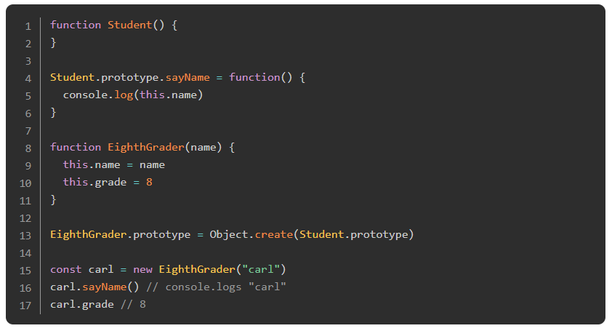
Recommended Method for Prototypal Inheritance
So far you have seen several ways of making an object inherit the prototype from another object. At this point in history, the recommended way of setting the prototype of an object is Object.create (here is the documentation for that method). Object.create very simply returns a new object with the specified prototype and any additional properties you want to add. For our purposes, you use it like so:

Slide 23
Recommended Method for Prototypal Inheritance
You can probably figure out what’s going on here. After creating the constructor for EighthGrader, we set its prototype to a new object that has a copy of Student.prototype.
A warning… this doesn’t work:

Slide 24
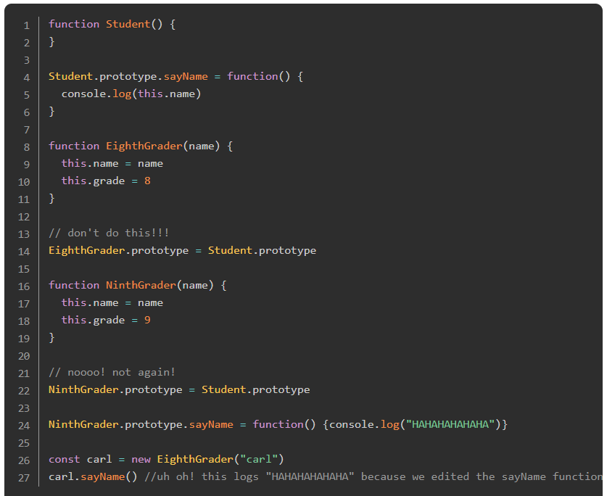
Recommended Method for Prototypal Inheritance
because it will literally set EighthGrader’s prototype to Student.prototype (i.e. not a copy), which could cause problems if you want to edit something in the future. Consider one more example:
Notes:
If we had used Object.create in this example, then we could safely edit the NinthGrader.prototype.sayName function without changing the function for EighthGrader as well.

Slide 25
Knowledge Check

Slide 26
Write an object constructor and instantiate the object.
Notes:
🍐 This is a Pear Deck Text Slide
🍐 To edit the type of question, go back to the "Ask Students a Question" in the Pear Deck sidebar.

Slide 27
Explain prototypal inheritance.
Notes:
🍐 This is a Pear Deck Text Slide
🍐 To edit the type of question, go back to the "Ask Students a Question" in the Pear Deck sidebar.

Slide 28
Explain what Object.create does
Notes:
🍐 This is a Pear Deck Text Slide
🍐 To edit the type of question, go back to the "Ask Students a Question" in the Pear Deck sidebar.

Slide 29
Resources
This article from Lydia Hallie and This video from Avelx explains the Prototype concept with graphics and simple language. Try using these resources if you want another perspective to understand the concept.
This Video from mpj explains Object.create method with great details about it, he walks through what it is, why Object.create exists in JavaScript, and how to use Object.create. Also you can check This Video from techsith to understand another point of view of extending objects from others by Object.create.
The Principles of Object-Oriented JavaScript book by Nicholas C. Zakas is really great to understand OOP in javascript, which explains concepts simply and in-depth, which explores JavaScript’s object-oriented nature, revealing the language’s unique implementation of inheritance and other key characteristics, it’s not free but it’s very valuable.
This stack overflow question explains the difference between defining methods via the prototype vs defining them in the constructor.

Slide 30
Challenge Time!

Slide 31
Challenge: Library
Let’s extend the ‘Book’ example from the previous lesson and turn it into a small Library app.

Slide 32
FACTORY FUNCTIONS AND THE MODULE PATTERN

Slide 33
What’s wrong with constructors?
Object constructors are one of about a million ways to start organizing your code. They are fairly common in the wild and are a fundamental building block of the JavaScript language.
However…
There are many people who argue against using constructors at all. Their arguments boil down to the fact that if you aren’t careful, it can be easy to introduce bugs into your code when using constructors. This article does a pretty decent job of outlining the issues (spoiler alert: the author ends up recommending factory functions).

Slide 34
What’s wrong with constructors?
One of the biggest issues with constructors is that while they look just like regular functions, they do not behave like regular functions at all. If you try to use a constructor function without the new keyword, your program will not work as expected, but it won’t produce error messages that are easy to trace.
The main takeaway is that while constructors aren’t necessarily evil, they aren’t the only way, and they may not be the best way either. Of course, this doesn’t mean that time learning about them was wasted! They are a common pattern in real-world code and many tutorials that you’ll come across on the net.

Slide 35
Learning Outcomes
Describe common bugs you might run into using constructors.
Write a factory method that returns an object.
Explain how scope works in JavaScript (bonus points if you can point out what ES6 changed!).
Explain what Closure is and how it impacts private functions & variables.
Describe how private functions & variables are useful.
Use inheritance in objects using the factory pattern.
Explain the module pattern.
Describe IIFE. What does it stand for?
Briefly explain namespacing and how it’s useful.

Slide 36
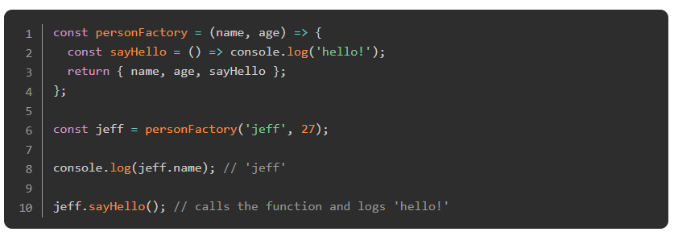
Factory function introduction
The factory function pattern is similar to constructors, but instead of using new to create an object, factory functions simply set up and return the new object when you call the function. Check out this example:

Slide 37
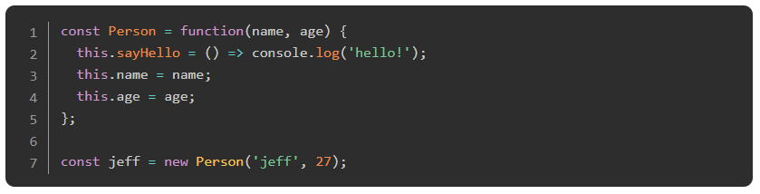
Factory function introduction
For reference, here is the same thing created using the constructor pattern:

Slide 38
Object Shorthand
A quick note about line 3 from the factory function example. In 2015, a handy new shorthand for creating objects was added into JavaScript. Without the shorthand, line 3 would have looked something like this:
Put simply, if you are creating an object where you are referring to a variable that has the exact same name as the object property you’re creating, you can condense it like so:

Slide 39
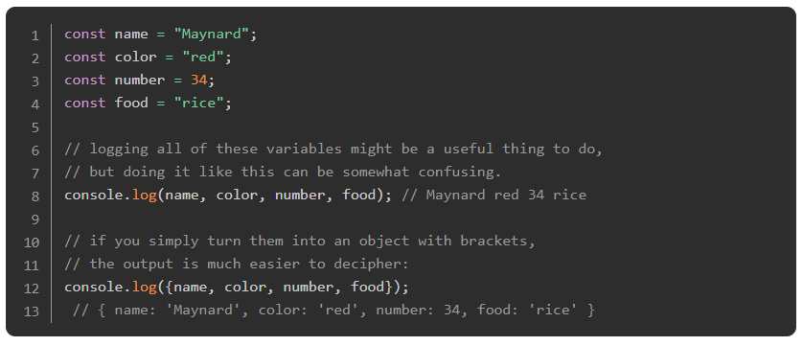
Object Shorthand
With that knowledge in your pocket, check out this little hack:

Slide 40
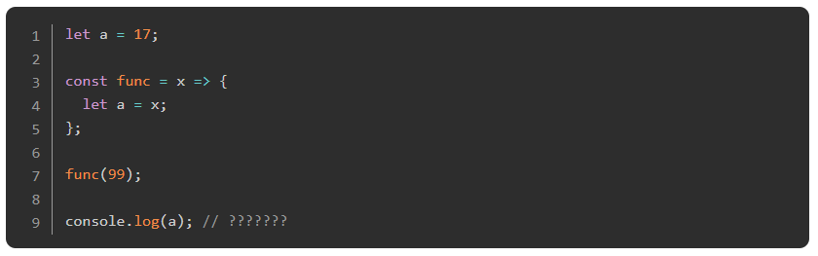
Scope and Closure
From simply reading the above example, you are probably already in pretty good shape to start using factory functions in your code. Before we get there though, it’s time to do a somewhat deep dive into an incredibly important concept: closure.
However, before we’re able to make sense of closure, we need to make sure you have a really good grasp on scope in JavaScript. Scope is the term that refers to where things like variables and functions can be used in your code.
In the following example, do you know what will be logged on the last line?

Slide 41
Scope and Closure
Is it 17 or 99? Do you know why? Can you edit the code so that it prints the other value?
The answer is 17, and the reason it’s not 99 is that on line 4, the outer variable a is not redefined, rather a new a is created inside the scope of that function. In the end, figuring out scope in most contexts is not all that complicated, but it is crucial to understanding some of the more advanced concepts that are coming up soon, so take your time to understand what’s going on in the following resources.

Slide 42
Watch this!
This video is simple and clear! Start here.
Notes:
🍐 This is a Pear Deck Web Slide.
🍐 To edit the type of question, go back to the "Ask Students a Question" in the Pear Deck sidebar.

Slide 43
Read
This article starts simple and reiterates what the video covered, but goes deeper and is more specific about the appropriate terminology. At the end, he defines closure and describes the module pattern, both of which we’ll talk about more soon.

Slide 44
Update
The previous article is great, but there is one inaccurate statement:
All scopes in JavaScript are created with Function Scope only, they aren’t created by for or while loops or expression statements like if or switch. New functions = new scope - that’s the rule
That statement was true in 2013 when the article was written, but ES6 has rendered it incorrect. Read this article to get the scoop!

Slide 45
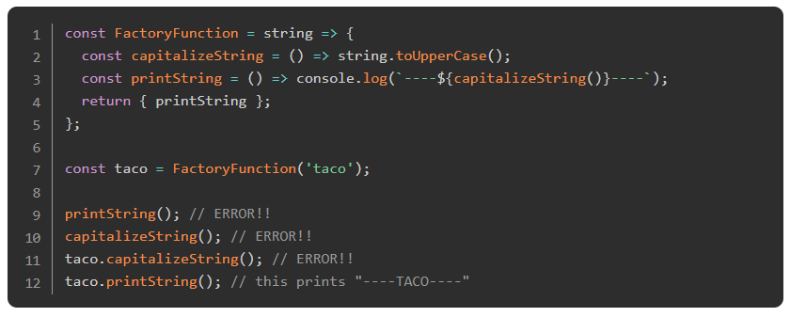
Private Variables and Functions
Now that we’ve cemented your knowledge of scope in JavaScript, take a look at this example:

Slide 46
Private Variables and Functions
Because of the concept of scope, neither of the functions created inside of FactoryFunction can be accessed outside of the function itself, which is why lines 9, 10, and 11 fail. The only way to use either of those functions is to return them in the object (see line 4), which is why we can call taco.printString() but not taco.capitalizeString(). The big deal here is that even though we can’t access the capitalizeString() function, printString() can. That is closure.
The concept of closure is the idea that functions retain their scope even if they are passed around and called outside of that scope. In this case, printString has access to everything inside of FactoryFunction, even if it gets called outside of that function.

Slide 47
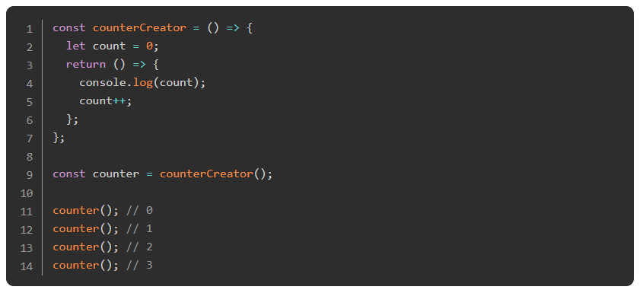
Private Variables and Functions
Here’s another example:

Slide 48
Private Variables and Functions
In this example, counterCreator initializes a local variable (count) and then returns a function. To use that function, we have to assign it to a variable (line 9). Then, every time we run the function it logs count to the console and increments it. Keep in mind, counter() is calling the return value of counterCreator. As above, the function counter is a closure. It has access to the variable count and can both print and increment it, but there is no other way for our program to access that variable.
In the context of factory functions, closures allow us to create private variables and functions. Private functions are functions that are used in the workings of our objects that are not intended to be used elsewhere in our program. In other words, even though our objects might only do one or two things, we are free to split our functions up as much as we want (allowing for cleaner, easier to read code) and only export the functions that the rest of the program is going to use. Using this terminology with our printString example from earlier, capitalizeString is a private function and printString is public.
The concept of private functions is very useful and should be used as often as is possible! For every bit of functionality that you need for your program, there are likely to be several supporting functions that do NOT need to be used in your program as a whole. Tucking these away and making them inaccessible makes your code easier to refactor, easier to test, and easier to reason about for you and anyone else that wants to use your objects.

Slide 49
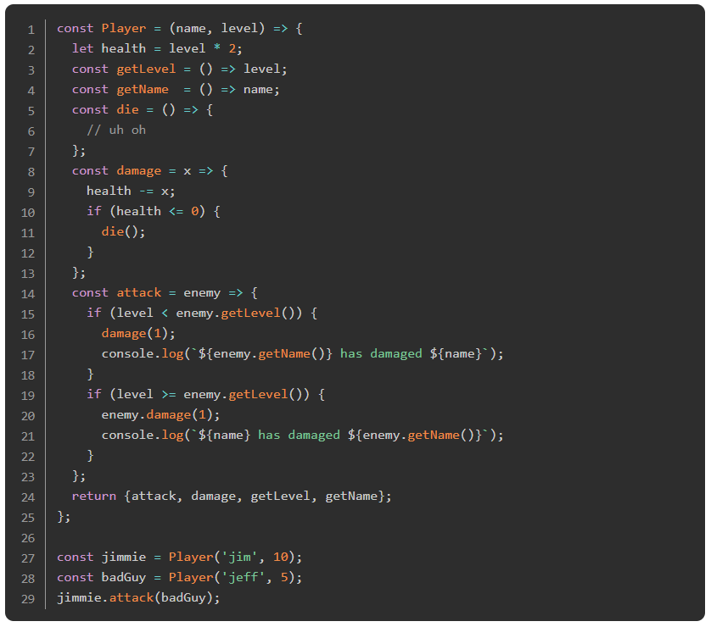
Back to Factory Functions
Now that we’ve got the theory out of the way, let’s return to factory functions. Factories are simply plain old JavaScript functions that return objects for us to use in our code. Using factories is a powerful way to organize and contain the code you’re writing. For example, if we’re writing any sort of game, we’re probably going to want objects to describe our players and encapsulate all of the things our players can do (functions!).

Slide 50
Back to Factory Functions
Take a minute to look through this example and see if you can figure out what’s going on.
What would happen here if we tried to call jimmie.die()? What if we tried to manipulate the health: jimmie.health -= 1000? Well, those are things that we have NOT exposed publicly so we would get an error. This is a very good thing! Setting up objects like this makes it easier for us to use them because we’ve actually put some thought into how and when we are going to want to use the information. In this case, we have jimmie’s health hiding as a private variable inside of the object which means we need to export a function if we want to manipulate it. In the long run, this will make our code much easier to reason about because all of the logic is encapsulated in an appropriate place.

Slide 51
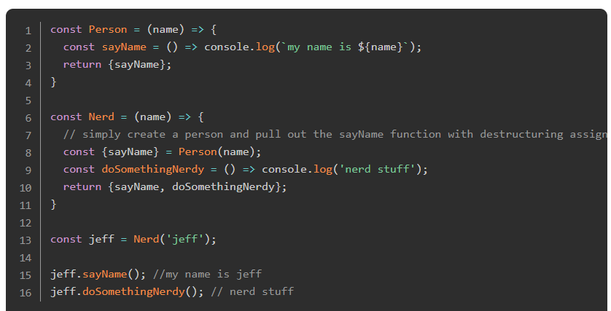
Inheritance with factories
In the constructors lesson, we looked fairly deeply into the concept of prototypes and inheritance, or giving our objects access to the methods and properties of another object. There are a few easy ways to accomplish this while using factories. Check this one out:

Slide 52
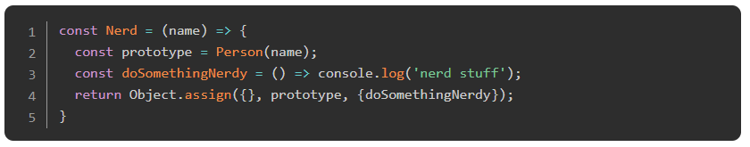
Inheritance with factories
This pattern is great because it allows you to pick and choose which functions you want to include in your new object. If you want to go ahead and lump ALL of another object in, you can certainly do that as well with Object.assign (read the docs for that one here).
Notes:
Before moving on have a look at this article. In the second half of the article, the author goes into some things that we aren’t really talking too much about here, but you’ll be rewarded if you spend some time figuring out what he’s talking about. Good stuff

Slide 53
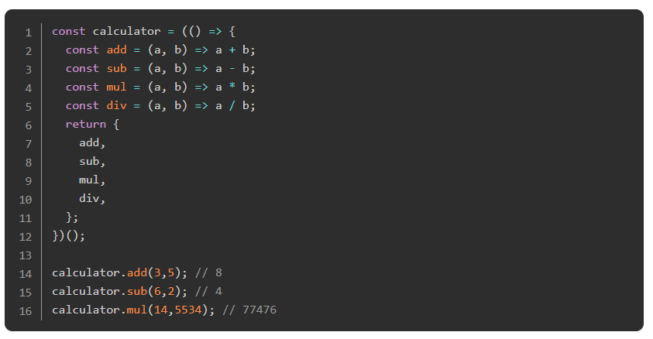
The Module Pattern
Quick sidenote: ES6 introduced a new feature in JavaScript called ‘modules’. These are essentially a syntax for importing and exporting code between different JavaScript files. They’re very powerful and we WILL be covering them later. They are not, however, what we’re talking about here.
Modules are actually very similar to factory functions. The main difference is how they’re created.
Meet a module:

Slide 54
The Module Pattern
The concepts are exactly the same as the factory function. However, instead of creating a factory that we can use over and over again to create multiple objects, the module pattern wraps the factory in an IIFE (Immediately Invoked Function Expression).

Slide 55
Read
Read up about IIFE’s in this article. The concept is simple: write a function, wrap it in parentheses, and then immediately call the function by adding () to the end of it.
Notes:
🍐 This is a Pear Deck Web Slide.
🍐 To edit the type of question, go back to the "Ask Students a Question" in the Pear Deck sidebar.

Slide 56
An Example
An example of creating and using a module pattern: JavaScript Module Pattern Basics.
Notes:
🍐 This is a Pear Deck Web Slide.
🍐 To edit the type of question, go back to the "Ask Students a Question" in the Pear Deck sidebar.
In our calculator example above, the function inside the IIFE is a simple factory function, but we can just go ahead and assign the object to the variable calculator since we aren’t going to need to be making lots of calculators, we only need one. Just like the factory example, we can have as many private functions and variables as we want, and they stay neatly organized, tucked away inside of our module, only exposing the functions we actually want to use in our program.

Slide 57
The Module Pattern
A useful side-effect of encapsulating the inner workings of our programs into objects is namespacing. Namespacing is a technique that is used to avoid naming collisions in our programs. For example, it’s easy to imagine scenarios where you could write multiple functions with the same name. In our calculator example, what if we had a function that added things to our HTML display, and a function that added numbers and operators to our stack as the users input them? It is conceivable that we would want to call all three of these functions add which, of course, would cause trouble in our program. If all of them were nicely encapsulated inside of an object, then we would have no trouble: calculator.add(), displayController.add(), operatorStack.add().

Slide 58
Knowledge Check

Slide 59
Describe common bugs you might run into using constructors.
Notes:
🍐 This is a Pear Deck Text Slide
🍐 To edit the type of question, go back to the "Ask Students a Question" in the Pear Deck sidebar.

Slide 60
Explain what Closure is and how it impacts private functions & variables.
Notes:
🍐 This is a Pear Deck Text Slide
🍐 To edit the type of question, go back to the "Ask Students a Question" in the Pear Deck sidebar.

Slide 61
Describe how private functions & variables are useful.
Notes:
🍐 This is a Pear Deck Text Slide
🍐 To edit the type of question, go back to the "Ask Students a Question" in the Pear Deck sidebar.

Slide 62
Briefly explain namespacing and how it’s useful.
Notes:
🍐 This is a Pear Deck Text Slide
🍐 To edit the type of question, go back to the "Ask Students a Question" in the Pear Deck sidebar.

Slide 63
Challenge Time!

Slide 64
Challenge: TIC TAC TOE
We’re making a Tic Tac Toe game you can play in your browser!

Slide 65
Classes

Slide 66
Introduction
JavaScript does not have classes in the same sense as other Object Oriented languages like Java or Ruby. ES6, however, did introduce a syntax for object creation that uses the class keyword. It is basically a new syntax that does the exact same thing as the object constructors and prototypes we learned about in the constructor lesson.
There is a bit of controversy about using the class syntax, however. Opponents argue that class is basically just syntactic sugar over the existing prototype-based constructors and that it’s dangerous and/or misleading to obscure what’s really going on with these objects. Despite the controversy, classes are beginning to crop up in real code bases that you are almost certainly going to encounter such as frameworks like React.
Since we’ve already gone fairly in-depth with Constructors, you don’t have too much left to learn here beyond the new syntax. If you choose to use classes in your code (that’s fine!) you can use them much the same way as object constructors.

Slide 67
Learning Outcomes
Describe the pros and cons of using classes in JavaScript.
Briefly discuss how JavaScript’s object creation differs from a language like Java or Ruby.
Explain the differences between using a class to define a constructor and other prototype methods.
Explain what “getters” & “setters” are.
Understand what computed names and class fields are.
Describe function binding.
Be able to use inheritance with classes.
Briefly talk about the conflict in JS with functional programming and classes.

Slide 68
Read
This article is probably just about all you need to start using class syntax confidently. “Getters and Setters” are a useful feature!
Notes:
🍐 This is a Pear Deck Web Slide.
🍐 To edit the type of question, go back to the "Ask Students a Question" in the Pear Deck sidebar.

Slide 69
Oh look API
The MDN docs are, as usual, a great resource for going a little deeper. Look especially at the ‘extends’ and ‘Mixins’ sections. React (and other frameworks) uses classes in this way. You create your components and make them extend the core React component which gives you access to all their built-in functionality.
Notes:
🍐 This is a Pear Deck Web Slide.
🍐 To edit the type of question, go back to the "Ask Students a Question" in the Pear Deck sidebar.

Slide 70
Pros and cons
This article provides some pros and cons for classes. There are many people who think that class syntax is misleading for Javascript, and thus Factory Functions (from the previous lesson) are inherently better. WE are not saying that classes are bad! We just want you to be informed on the opinions of both sides.
Notes:
🍐 This is a Pear Deck Web Slide.
🍐 To edit the type of question, go back to the "Ask Students a Question" in the Pear Deck sidebar.

Slide 71
Practice time
Go back to your “Library” example and refactor it to use class instead of plain constructors.
Don’t overwrite the original
Try this!!!

Slide 72
Knowledge Check

Slide 73
Describe the pros and cons of using classes in JavaScript.
Notes:
🍐 This is a Pear Deck Text Slide
🍐 To edit the type of question, go back to the "Ask Students a Question" in the Pear Deck sidebar.

Slide 74
Explain the differences between using a class to define a constructor and other prototype methods.
Notes:
🍐 This is a Pear Deck Text Slide
🍐 To edit the type of question, go back to the "Ask Students a Question" in the Pear Deck sidebar.

Slide 75
Explain what “getters” & “setters” are.
Notes:
🍐 This is a Pear Deck Text Slide
🍐 To edit the type of question, go back to the "Ask Students a Question" in the Pear Deck sidebar.

Slide 76
ES6

Slide 77
Introduction
Separate from the module pattern that we discussed in an earlier lesson, “modules” is a feature that arrived with ES6. Browser support for this feature is quite slim at this point, but is slowly improving, and until all modern browsers support it, we can make it work using an external module bundler. ES6 modules are starting to appear in many code bases around the net and getting them up and running will give us a chance to explore some new parts of the JavaScript ecosystem, so it’s going to be a worthy excursion!
Don’t be fooled! We’re going to cover much more than just the new module syntax in this lesson! Before we can really use these modules, we’re going to have to learn about npm and webpack, which are both topics that will be very useful to you even beyond this lesson. In the end, the modules themselves are simple to implement, so we’re going to take this chance to learn about a few other things.

Slide 78
Learning Outcomes
Explain what npm is and where it was commonly used before being adopted on the frontend.
Describe what npm init does and what package.json is.
Know how to install packages using npm.
Describe what a JavaScript module bundler like webpack is.
Explain what the concepts “entry” and “output” mean as relates to webpack.
Briefly explain what a development dependency is.
Explain what “transpiling code” means and how it relates to front-end development.
Briefly describe what a task runner is and how it’s used in front-end development.
Describe how to write an npm automation script.
Explain one of the main benefits of writing code in modules.
Explain “named” exports and “default” exports.

Slide 79
The History of JavaScript
Why do we even need or want this stuff? What do you gain from all of this added complexity? These are good questions.. with good answers.
Read this article for a bit of a history lesson. It’s long, but it puts what we’re doing here in great perspective. This article is a bit older, and those who have coded along with the example have frequently run into issues, so we don’t suggest that you code along (you’ll be following along with the official Webpack documentation later). Nevertheless, this article is extremely important conceptually and really clarifies the ‘WHY’ of the rest of this lesson.
Notes:
🍐 This is a Pear Deck Web Slide.
🍐 To edit the type of question, go back to the "Ask Students a Question" in the Pear Deck sidebar.

Slide 80
npm
Read through the npm links below but don’t worry about running any of the commands on your computer. This section is about growing your awareness of npm. You will have an opportunity to use what you learn here in upcoming projects.
Take a couple minutes to read the About npm page - a great introduction to npm.
This video teaches you how to install packages with npm.
This tutorial covers the package.json file, which you can use to manage your project’s dependencies.
If you run into trouble at any point you can check out the official docs page for more tutorials and documentation.

Slide 81
Yarn?
At some point, you will probably run into Yarn - a replacement for the default npm. For the most part, it does the same things, though it does have a few more features. Recent versions of npm have incorporated some of the best features of Yarn, so using it won’t offer you any real advantages at this point in your career. It is a fine project, however, and may be worth your consideration in the future.

Slide 82
Webpack
Webpack is simply a tool for bundling modules. There is a lot of talk across the net about how difficult and complex it is to set up and use, but at the moment our needs are few and the setup is simple enough. In fact, you can see an example of getting it up and running on the front page of their website.
Webpack is a very powerful tool, and with that power comes a decent amount of complexity - just look at the sample config file on this page 😱. Don’t let it scare you off! The basic configuration is not difficult and proficiency with webpack looks amazing on resumes.

Slide 83
Webpack
To get us started, we are going to refer to the official documentation.
Code along with all of the steps of this tutorial (“Basic Setup” through “Conclusion”).
Let’s discuss what’s going on there. After installing webpack using npm, we set up a simple project that required an external library (lodash - check it out here if it’s new to you) using a simple script tag. The site lists a few reasons why this is probably not ideal and then steps through using webpack to accomplish the same thing.

Slide 84
Webpack
There are a couple of key concepts to understanding how webpack works - entry and output. In this example, we rearranged the files into a src and dist folder. Technically we could have called those folders anything, but those names are typical. src is our source directory. In other words, src is where we write all of the code that webpack is going to bundle up for us. When webpack runs, it goes through all of our files looking for any import statements and then compiles all of the code we need to run our site into a single file inside of the dist folder (short for distribution). Our entry file, then is the main application file that links (either directly or indirectly) to all of the other modules in our project. In this example, it is /src/index.js. The output file is the compiled version - dist/main.js.
Browse this document for more details. We’ll talk plugins and loaders in another lesson.

Slide 85
ES6 Modules
Now that we (sorta) understand what webpack is doing it’s time to discuss the module syntax. There are only 2 components to it - import and export.
Take a moment to look at the docs for import and export.
Of course, the import statement is the same thing that you used during the webpack tutorial! These things are simple to use.

Slide 86
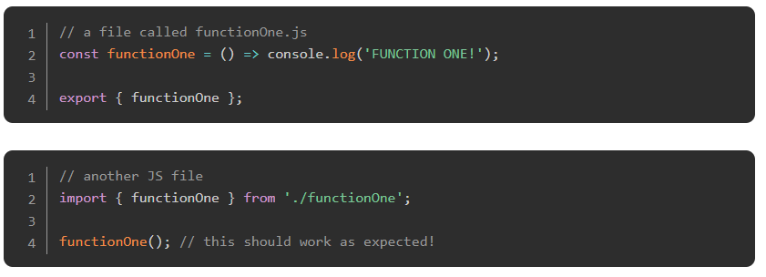
ES6 Modules

Slide 87
ES6 Modules
There are many benefits to writing your code in modules. One of the most compelling is code reuse. If, for instance, you have written some functions that manipulate the DOM in a specific way, putting all of those into their own file as a ‘module’ means that you can copy that file and re-use it very easily!
There are also the same benefits as when using factory functions or the module pattern (the module pattern and ES6 modules are not the same things; this naming convention is frustrating). By using ES6 modules, you can keep different parts of your code cleanly separated, which makes writing and maintaining your code much easier and less error-prone. Keep in mind that you can definitely export constructors, classes and factory functions from your modules.

Slide 88
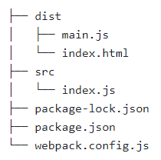
ES6 Modules
To pull it all together, let’s write a simple module and then include it in our code. We are going to continue from where the webpack tutorial left off. Before beginning, your file directory should look something like this:

Slide 89
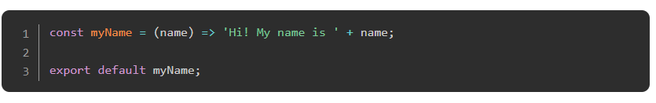
ES6 Modules
In addition, you should be able to bundle and run webpack by simply typing npx webpack in the terminal.
Add a new file to the src directory called myName.js with the following contents:

Slide 90
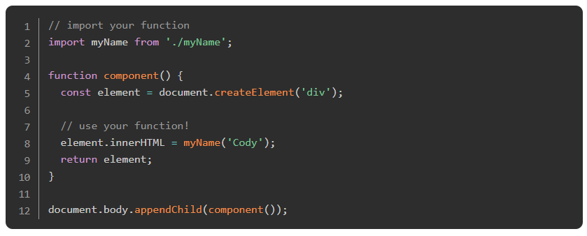
ES6 Modules
Then, in src/index.js, import and use your new function:
Notes:
Easy! Now, if you run npx webpack in your project directory, your page should show our new function being used.

Slide 91
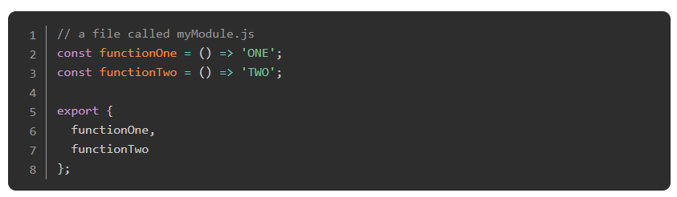
ES6 Modules
There are 2 different ways to use exports in your code: named exports and default exports. Which option you use depends on what you’re exporting. As a general rule if you want to export multiple functions use named exports with this pattern:

Slide 92
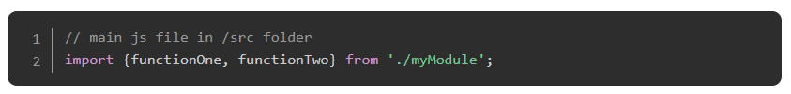
ES6 Modules
And to import them:
Using this pattern gives you the freedom to only import the functions you need in the various files of your program. So it’s perfectly fine to only import functionOne if that’s the only one you need.
The various import/export methods are best explained in the docs that we linked earlier - import and export.

Slide 93
Knowledge Check

Slide 94
Explain what npm is and where it was commonly used before being adopted on the frontend.
Notes:
🍐 This is a Pear Deck Text Slide
🍐 To edit the type of question, go back to the "Ask Students a Question" in the Pear Deck sidebar.

Slide 95
Describe what npm init does and what package.json is.
Notes:
🍐 This is a Pear Deck Text Slide
🍐 To edit the type of question, go back to the "Ask Students a Question" in the Pear Deck sidebar.

Slide 96
Briefly explain what a development dependency is.
Notes:
🍐 This is a Pear Deck Text Slide
🍐 To edit the type of question, go back to the "Ask Students a Question" in the Pear Deck sidebar.

Slide 97
Describe how to write an npm automation script.
Notes:
🍐 This is a Pear Deck Text Slide
🍐 To edit the type of question, go back to the "Ask Students a Question" in the Pear Deck sidebar.

Slide 98
Webpack

Slide 99
Introduction
We’ve already introduced webpack in a previous lesson. It is the go-to tool across the web for bundling and compiling javascript code. There are other options out there, but at this time none of them are as popular or widely used as webpack.
In our last lesson, we covered the first half of what webpack can do for you: bundling your modules. Another amazing feature is webpack’s ability to process and manipulate your code during the compilation step. So, for example, if you would like to use Sass to write your CSS, webpack can do that for you. Webpack can manage your images and compress and optimize them for use on the web. Webpack can minify and uglify your code. There are tons of things webpack can do, but to access these functions we need to learn more about loaders and plugins.

Slide 100
Learning Outcomes
Use webpack by following its documentation.
Load assets with webpack.
Manage output with webpack.

Slide 101
Tutorial
Go through this tutorial to see examples of using webpack to manage your website’s assets.

Slide 102
More Tutorials
Read through this tutorial to learn how to let webpack automatically manage your index.html and insert your bundle into the page for you!

Slide 103
Source Maps
Finally, the first part of this tutorial talks about source maps, a handy way to track down which source file (index.js, a.js, b.js) an error is coming from when you use webpack to bundle them together. This is essential to debugging bundled code in your browser’s DevTools. If the error comes from b.js the error will reference that file instead of the bundle. It also walks through an example of the --watch feature you definitely should have taken note of above.

Slide 104
Knowledge Check

Slide 105
How do you load CSS using webpack?
Notes:
🍐 This is a Pear Deck Text Slide
🍐 To edit the type of question, go back to the "Ask Students a Question" in the Pear Deck sidebar.

Slide 106
How do you load images using webpack?
Notes:
🍐 This is a Pear Deck Text Slide
🍐 To edit the type of question, go back to the "Ask Students a Question" in the Pear Deck sidebar.

Slide 107
How would you track errors in bundled source code?
Notes:
🍐 This is a Pear Deck Text Slide
🍐 To edit the type of question, go back to the "Ask Students a Question" in the Pear Deck sidebar.

Slide 108
Challenge Time!

Slide 109
PROJECT: RESTAURANT PAGE
Let’s use what we’ve learned and take a chance to continue practicing DOM manipulation by dynamically rendering a simple restaurant homepage! By the end, we are going to be using JavaScript alone to generate the entire contents of the website!

Slide 110
OOP PRINCIPLES

Slide 111
Introduction
By this point, you will have learned and had a chance to practice the most common object-creation and organization patterns in JavaScript. But that is just the tip of the iceberg. More important than learning the syntax for factory functions or modules is figuring out how to use them effectively.
This whole series of lessons has been about the “Object Oriented Programming” paradigm (OOP). The basics of creating objects and classes are relatively straightforward. But it is not straightforward to decide what to put in each object, or when to make a new object, or when to let an object ‘inherit’ from another one.

Slide 112
Learning Outcomes
Explain the “Single Responsibility Principle”.
Briefly explain the additional SOLID principles.
Explain what “tightly coupled” objects are and why we want to avoid them.
Notes:
Luckily there are several concepts and principles that can guide us into making good decisions when it comes to our objects. This lesson is an introduction to the most important of those concepts. Keep in mind that there is not usually a very clear answer to your application design questions. Some patterns and ideas are obviously better than others, but there is often some trade-off when deciding where to put a specific function. In other words.. these principles are not rules- they’re helpful guidelines.
As you read these resources, it might help to go back to some projects you’ve already done and think about how what you’ve written measures up to the examples you see. And of course, as you move on, keep these things in mind when crafting new projects

Slide 113
Single Responsibility
As you craft your objects, one of the most important things to remember is the Single Responsibility Principle which states that a class (or object or module.. you get the point) should only have one responsibility. This doesn’t mean that an object can only do one thing, but it does mean that everything an object does should be part of one responsibility.
Here’s a really common example. Most of our code has functions to update and write things to the DOM in addition to our application logic. It’s a really good idea to separate your DOM stuff from the application logic.

Slide 114
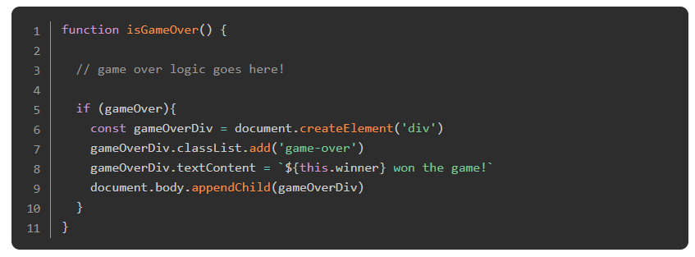
Single Responsibility
So instead of this:

Slide 115
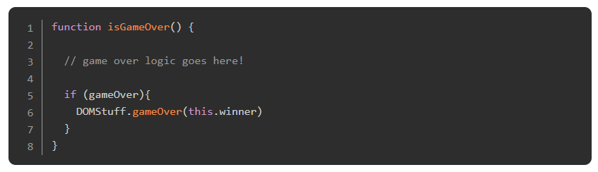
Single Responsibility
You should extract all the DOM manipulation into its own module and use it like so:

Slide 116
Single Responsibility
In fact - the function isGameOver shouldn’t be calling the DOM function anyway. That should go elsewhere (directly in the game-loop).
Another way to think about the Single Responsibility Principle is that a given method/class/component should have a single reason to change. Otherwise, if an object is trying to have multiple responsibilities, changing one aspect might affect another.
The Single Responsibility Principle is the first of a commonly found set of 5 design principles called the SOLID principles. You will read more about these principles in the assignment articles below.

Slide 117
Loosely Coupled Objects
Obviously, all of our objects are intended to work together to form our final application. You should take care, however, to make sure that your individual objects can stand alone as much as possible. Tightly coupled objects are objects that rely so heavily on each other that removing or changing one will mean that you have to completely change another one - a real bummer.
This one is related pretty strongly to ‘Single Responsibility’ but takes a different angle. As an example, if we were writing a game and wanted to completely change how the User Interface worked, we should be able to do that without completely reworking the game logic. So we should be able to start off writing our game using primarily console.logs() and then add in a bunch of DOM functions later without touching the game logic.

Slide 118
Read
Read SOLID JavaScript: The Single Responsibility Principle. NOTE: This article does make use of JQuery, one of the earliest and most popular JavaScript libraries prior to the ES6 standard. While The Odin Project does not teach JQuery and you are not expected to understand the example, be sure to focus less on the code itself and more on the SOLID concepts being expressed.

Slide 119
Another Read
5 Principles that will make you a SOLID JavaScript Developer hits the same topic, and also covers the rest of ‘SOLID’ concisely.

Slide 120
Knowledge Check

Slide 121
Explain the “Single Responsibility Principle”.
Notes:
🍐 This is a Pear Deck Text Slide
🍐 To edit the type of question, go back to the "Ask Students a Question" in the Pear Deck sidebar.

Slide 122
Briefly explain the additional SOLID principles.
Notes:
🍐 This is a Pear Deck Text Slide
🍐 To edit the type of question, go back to the "Ask Students a Question" in the Pear Deck sidebar.

Slide 123
Challenge Time!

Slide 124
Challenge: TODO List
At this point you’ve already had a fair amount of practice using the various techniques we’ve shown you. But we’ve been throwing a lot of information your way, so before we move on we’re going to take a minute to slow down and work on one more great portfolio project.

